Slide 1
Last Man Standing
Natalie Gorr

Slide 2
Last Man Standing Problem
There are n people standing in a circle waiting to be executed. Starting from the first man, k−1 people are skipped and the k-th man is executed. Then again, k − 1 people are skipped and the k-th man is executed. The elimination proceeds around the circle (which is becoming smaller and smaller as the executed people are removed), until only the last man remains. You are given number of people standing in the circle, and number k. You must find the number of last man, who standing in the circle.
n (0 < n ≤ 106) and k (0 < k ≤ 109).

Slide 3
Example:
n = 6, k = 3
1
6
2
6 men arranged in a circle
5
3
4

Slide 4
Example:
n = 6, k = 3
1
6
2
6 men arranged in a circle
Go clockwise
5
3
4

Slide 5
Example:
n = 6, k = 3
1
6
2
Starting at 1:
5
3
4

Slide 6
Example:
n = 6, k = 3
1
6
2
Starting at 1:
Skip 1
5
3
4

Slide 7
Example:
n = 6, k = 3
1
6
2
Starting at 1:
Skip 1
Skip 2
5
3
4

Slide 8
Example:
n = 6, k = 3
1
6
2
Starting at 1:
Skip 1
Skip 2
Kill 3
5
3
4

Slide 9
Example:
n = 6, k = 3
1
6
2
Remove 3 from the circle
5
4

Slide 10
Example:
n = 6, k = 3
1
6
2
Resume count from 4:
Skip 4
5
4

Slide 11
Example:
n = 6, k = 3
1
6
2
Resume count from 4:
Skip 4
Skip 5
5
4

Slide 12
Example:
n = 6, k = 3
1
6
2
Resume count from 4:
Skip 4
Skip 5
Kill 6
5
4

Slide 13
Example:
n = 6, k = 3
1
2
Remove 6 from the circle
5
4

Slide 14
Example:
n = 6, k = 3
1
2
Restart the count from 1:
Skip 1
5
4

Slide 15
Example:
n = 6, k = 3
1
2
Restart the count from 1:
Skip 1
Skip 2
5
4

Slide 16
Example:
n = 6, k = 3
1
2
Restart the count from 1:
Skip 1
Skip 2
Kill 4
5
4

Slide 17
Example:
n = 6, k = 3
1
2
Remove 4 from the circle
5

Slide 18
Example:
n = 6, k = 3
1
2
Restart count from 5:
Skip 5
5

Slide 19
Example:
n = 6, k = 3
1
2
Restart count from 5:
Skip 5
Skip 1
5

Slide 20
Example:
n = 6, k = 3
1
2
Restart count from 5:
Skip 5
Skip 1
Kill 2
5

Slide 21
Example:
n = 6, k = 3
1
Remove 2 from the circle
5

Slide 22
Example:
n = 6, k = 3
1
Restart count from 5:
Skip 5
5

Slide 23
Example:
n = 6, k = 3
1
Restart count from 5:
Skip 5
Skip 1
5

Slide 24
Example:
n = 6, k = 3
1
Restart count from 5:
Skip 5
Skip 1
Kill 5
5

Slide 25
Example:
n = 6, k = 3
1
Remove 5 from the circle

Slide 26
Example:
n = 6, k = 3
1
Last man standing is 1

Slide 27
Example:
n = 5, k = 2
1
5
2
5 men arranged in a circle
4
3

Slide 28
Example:
n = 5, k = 2
1
5
2
Start with position 1:
4
3

Slide 29
Example:
n = 5, k = 2
1
5
2
Start with position 1:
Skip 1
4
3

Slide 30
Example:
n = 5, k = 2
1
5
2
Start with position 1:
Skip 1
Kill 2
4
3

Slide 31
Example:
n = 5, k = 2
1
5
Remove 2 from the circle
4
3

Slide 32
Example:
n = 5, k = 2
1
5
Resume count from 3
4
3

Slide 33
Example:
n = 5, k = 2
1
5
Resume count from 3
Skip 3
4
3

Slide 34
Example:
n = 5, k = 2
1
5
Resume count from 3
Skip 3
Kill 4
4
3

Slide 35
Example:
n = 5, k = 2
1
5
Remove 4 from the circle
3

Slide 36
Example:
n = 5, k = 2
1
5
Resume count from 5
3

Slide 37
Example:
n = 5, k = 2
1
5
Resume count from 5
Skip 5
3

Slide 38
Example:
n = 5, k = 2
1
5
Resume count from 5
Skip 5
Kill 1
3

Slide 39
Example:
n = 5, k = 2
5
Resume count from 3
3

Slide 40
Example:
n = 5, k = 2
5
Resume count from 3
Skip 3
3

Slide 41
Example:
n = 5, k = 2
5
Resume count from 3
Skip 3
Kill 5
3

Slide 42
Example:
n = 5, k = 2
Remove 5
3

Slide 43
Example:
n = 5, k = 2
3 is the winner
3

Slide 44
Questions to consider?
How can we model this problem using code?
What is an appropriate data structure to use?
What is the performance of this algorithm?

Slide 45
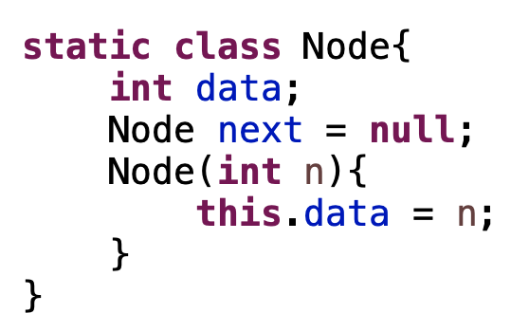
We can model the circle using a circular linked list
Within the Main class: Node class which stores integer data

Slide 46
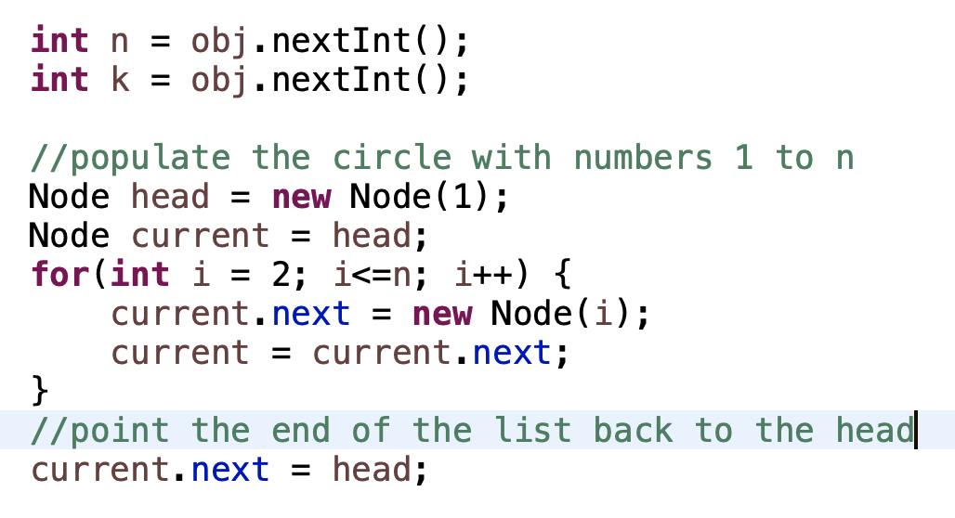
We can model the circle using a circular linked list
Inside of the main method:
Start the head with Node containing 1
Create and link nodes 2-n
Point the nth node back to the head

Slide 47
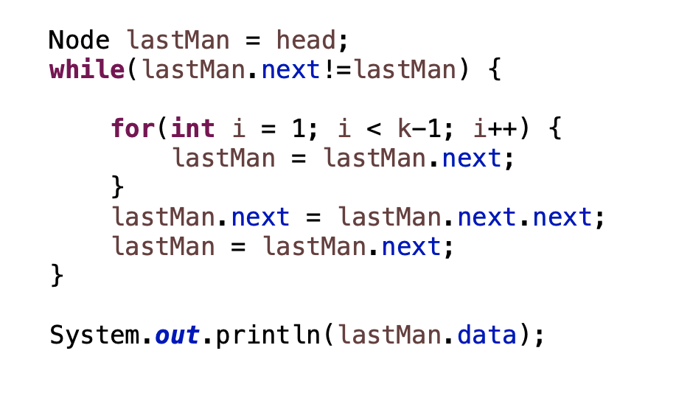
We can model the circle using a circular linked list
Inside of the main method:
Initially the last man is pointed to head node containing person 1

Slide 48
We can model the circle using a circular linked list
Inside of the main method:
Initially the last man is pointed to head node containing person 1
If head.next points to itself, there is only one node in the circle

Slide 49
We can model the circle using a circular linked list
Inside of the main method:
Initially the last man is pointed to head node containing person 1
If head.next points to itself, there is only one node in the circle
Skip k-1 men, example: k = 4, i = 1, 2 < 3

Slide 50
We can model the circle using a circular linked list
Inside of the main method:
Initially the last man is pointed to head node containing person 1
If head.next points to itself, there is only one node in the circle
Skip k-1 men, example: k = 4, i = 1, 2 < 3
LastMan
Prior to entering the loop:
lastMan
1
2
3
4

Slide 51
We can model the circle using a circular linked list
Inside of the main method:
Initially the last man is pointed to head node containing person 1
If head.next points to itself, there is only one node in the circle
Skip k-1 men, example: k = 4, i = 1, 2 < 3
LastMan
i= 1
1
2
3
4

Slide 52
We can model the circle using a circular linked list
Inside of the main method:
Initially the last man is pointed to head node containing person 1
If head.next points to itself, there is only one node in the circle
Skip k-1 men, example: k = 4, i = 1, 2 < 3
1
LastMan
i= 2
2
3
4

Slide 53
We can model the circle using a circular linked list
Inside of the main method:
Initially the last man is pointed to head node containing person 1
If head.next points to itself, there is only one node in the circle
Skip k-1 men, example: k = 4, i = 1, 2, 3
Remove kth position in the circle by pointing k-1.next pointer to k+1

Slide 54
We can model the circle using a circular linked list
Inside of the main method:
Initially the last man is pointed to head node containing person 1
If head.next points to itself, there is only one node in the circle
Skip k-1 men, example: k = 4, i = 1, 2, 3
Remove kth position in the circle by pointing k-1.next pointer to k+1
k
k-1
k+1

Slide 55
We can model the circle using a circular linked list
Inside of the main method:
Initially the last man is pointed to head node containing person 1
If head.next points to itself, there is only one node in the circle
Skip k-1 men, example: k = 4, i = 1, 2, 3
Remove kth position in the circle by pointing k-1.next pointer to k+1
k
k-1
k+1

Slide 56
We can model the circle using a circular linked list
Inside of the main method:
Initially the last man is pointed to head node containing person 1
If head.next points to itself, there is only one node in the circle
Skip k-1 men, example: k = 4, i = 1, 2, 3
Remove kth position in the circle by pointing k-1.next pointer to k+1
k-1
k+1

Slide 57
We can model the circle using a circular linked list
Inside of the main method:
Initially the last man is pointed to head node containing person 1
If head.next points to itself, there is only one node in the circle
Skip k-1 men, example: k = 4, i = 1, 2, 3
Remove kth position in the circle by pointing k-1.next pointer to k+1
k-1
k+1

Slide 58
Analysis of time complexity:
Initially create a circular linked list with Nodes n-1
This is time complexity O(n)

Slide 59
Analysis of time complexity:
For the main part of the alg, we consider the outer and inner loops

Slide 60
Analysis of time complexity:
Outer loop
This outer loop removes exactly n-1 nodes, so it is O(n)

Slide 61
Analysis of time complexity:
The inner loop runs k-2 times so it is O(k)

Slide 62
Analysis of time complexity:
Hence the whole loop runs in O(n*k)

Slide 63
Analysis of time complexity:
Can we do better?
Time to create linked list: O(n)
Double loop: O(n*k)
Total = O(n) + O(n*k) = O(2*n*k) = O(n*k)
O(n*k)<= 109*106

Slide 64
Consider this problem using recursive steps

Slide 65
Consider this problem using recursive steps
We know what the base case has to be, regardless of k:
lastMan(1, k) = 1

Slide 66
Consider this problem using recursive steps
We know each step, the circle of n people gets reduced by 1 to n-1

Slide 67
Consider this problem using recursive steps
We know each step, the circle of n people gets reduced by 1 to n-1
Let’s see if we can define a relationship between lastMan(n, k) and lastMan(n-1, k)
Consider arbitrary n, k = 3

Slide 68
Consider this problem using recursive steps
We know each step, the circle of n people gets reduced by 1 to n-1
Let’s see if we can define a relationship between lastMan(n, k) and lastMan(n-1, k)
Consider arbitrary n, k = 3
1 | 2 | 3 | 4 | 5 | ... | n

Slide 69
Consider this problem using recursive steps
We know each step, the circle of n people gets reduced by 1 to n-1
Let’s see if we can define a relationship between lastMan(n, k) and lastMan(n-1, k)
Consider arbitrary n, k = 3
1 | 2 | 3 | 4 | 5 | ... | n

Slide 70
Consider this problem using recursive steps
We know each step, the circle of n people gets reduced by 1 to n-1
Let’s see if we can define a relationship between lastMan(n, k) and lastMan(n-1, k)
Consider arbitrary n, k = 3
1 | 2 | 3 | 4 | 5 | ... | n
We will resume the count from 4

Slide 71
Consider this problem using recursive steps
So the updated solution to lastMan (n, 3) will really look like:
4 | 5 | 6 | ... | n-1 | 1 | 2

Slide 72
Consider this problem using recursive steps
So the updated solution lastMan (n, 3) will really look like:
This is algorithmically the same as finding the solution to lastMan (n-1, 3)
4 | 5 | 6 | ... | n-1 | 1 | 2
1 | 2 | 3 | 4 | 5 | ... | n-1

Slide 73
Consider this problem using recursive steps
So the updated solution lastman (n, 3) will really look like:
This is algorithmically the same as finding the solution to lastMan (n-1, 3)
However we have to account for different starting positions:
LastMan(n, 3) = LastMan(n-1, 3) + 3
4 | 5 | 6 | ... | n-1 | 1 | 2
1 | 2 | 3 | 4 | 5 | ... | n-1

Slide 74
Consider this problem using recursive steps
So the updated solution lastman (n, 3) will really look like:
This is algorithmically the same as finding the solution to lastMan (n-1, 3)
However we have to account for different starting positions:
Don’t forget this is a circle, if for the jth iteration LastMan(n-j, 3) + 3 > n-j+1, we need to wrap around the circle (use mod)
LastMan(n, 3) = (LastMan(n-1, 3) + 3)%n
4 | 5 | 6 | ... | n-1 | 1 | 2
1 | 2 | 3 | 4 | 5 | ... | n-1

Slide 75
Consider this problem using recursive steps
We can easily generalize this for an arbitrary k

Slide 76
Consider this problem using recursive steps
We can easily generalize this for an arbitrary k
This is algorithmically the same as finding the solution to lastMan (n-1, k)
LastMan(n, k) = (LastMan(n-1, k) + k)%n
1 | ... | k-1 | k | k+1 | ... | n
k+1 | k+2 | ... | n-1 | 1 | ... | k-1

Slide 77
Consider this problem using recursive steps
Up to this point this the relation is fairly intuitive, but there is a small issue

Slide 78
Consider this problem using recursive steps
Up to this point this the relation is fairly intuitive, but there is a small issue
Imagine a lastman(n,k) with n, k such that the last man standing is person n
1 | 2 | 3 | 4 | ... | n
winner

Slide 79
Consider this problem using recursive steps
Up to this point this the relation is fairly intuitive, but there is a small issue
Imagine a lastman(n,k) with n, k such that the last man standing is person n
LastMan(n-1, k) will return n-k
LastMan(n, k)= (n-k + k)%n will return 0
1 | 2 | 3 | 4 | ... | n

Slide 80
Consider this problem using recursive steps
Up to this point this the relation is fairly intuitive, but there is a small issue
Imagine a lastman(n,k) with n, k such that the last man standing is person n
LastMan(n-1, k) will return n-k
LastMan(n, k)= (n-k + k)%n will return 0
We want LastMan(n-1, k) to return n-k-1
1 | 2 | 3 | 4 | ... | n

Slide 81
Consider this problem using recursive steps
Up to this point this the relation is fairly intuitive, but there is a small issue
Imagine a lastman(n,k) with n, k such that the last man standing is person n
LastMan(n-1, k) will return n-k
LastMan(n, k)= (n-k + k)%n will return 0
We want LastMan(n-1, k) to return n-k-1
So that LastMan(n, k)= (n-k-1 +k)%n = (n-1)%n = n-1
From here we just add one to n-1 -> n-1+1 = n
1 | 2 | 3 | 4 | ... | n

Slide 82
Consider this problem using recursive steps
LastMan(n-1, k) will return n-k
LastMan(n, k)= (n-k + k)%n will return 0
We want LastMan(n-1, k) to return n-k-1
So that LastMan(n, k)= (n-k-1 +k)%n = (n-1)%n = n-1
From here we just add one to n-1 -> n-1+1 = n
So our Final Recurrence relation:
LastMan(n, k) = (LastMan(n-1, k) + k-1)% n+1

Slide 83
Final form
Base Case: lastMan(1,k) = 1
General Case: LastMan(n, k) = (LastMan(n-1, k) + k-1)% n+1

Slide 84
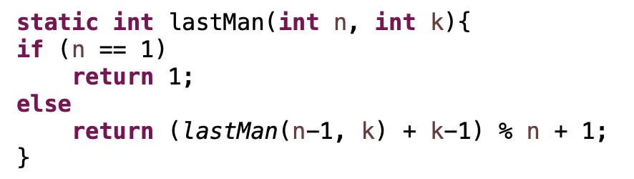
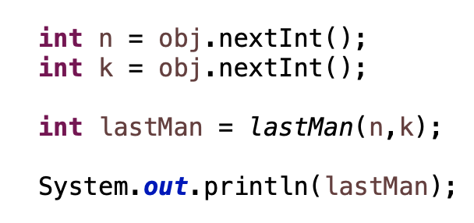
Code
Recursive function
Within Main function:

Slide 85
Time complexity:
The recursive function is called exactly n times so the whole thing runs in O(n)
O(n) <= 106

Slide 86
Ex (6,3)
lm(6,3) = (lm(5,3)+2)%6+1
lm(5,3) = (lm(4,3)+2)%5+1
lm(4,3) = (lm(3,3)+2)%4+1
lm(3,3) = (lm(2,3)+2)%3+1
lm(2,3) = (lm(1,3)+2)%2+1
lm(1,3) = 1
lm(1,3) = 1
lm(2,3) = (1+2)%2+1 = 3%2 +1 = 1+1= 2
lm(3,3) = (2+2)%3+1 = 2
lm(4,3) = (2+2)%4+1 = 1
lm(5,3) = (1+2)%5+1 = 4
lm(6,3) = (4+2)%6+1 = 1

Slide 87
Ex (5,2)
lm(5,2) = (lm(4,2)+1)%5+1
lm(4,2) = (lm(4,2)+1)%4+1
lm(3,2) = (lm(3,2)+1)%3+1
lm(2,2) = (lm(2,2)+1)%2+1
lm(1,2) = 1
lm(1,2) = 1
lm(2,2) = (1+1)%2+1 = 1
lm(3,2) = (1+1)%3+1 = 3
lm(4,2) = (3+1)%4+1 = 1
lm(5,2) = (1+1)%5+1 = 3

Slide 88
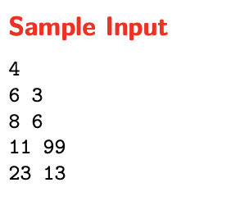
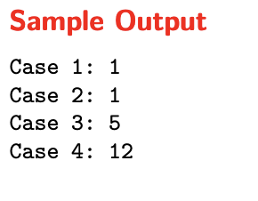
Important things to note:
The first line contains integer k (0 < k ≤ 100), it is the number of tests. On each of next k lines there are 2 integers n (0 < n ≤ 106 ) and k (0 < k ≤ 109 ).
We have multiple cases:
Number of cases
Each (n, k) pair
Once we have the algorithm for one case, it’s easy to repeat for the other cases

